Slide 1

Chess Playing Robot
Proposed by: Saad Bin Tariq (18S-BSCS-03)
Supervised by: Dr. Altaf Hussain
Dr. A. Q. Khan Institute of Computer Sciences & Information Technology, KICSIT
University of Engineering & Technology, Taxila

Slide 2
Outline
Introduction
Problem Statement
Problem Solution
Proposed Scope
Chess Engine
Working Architecture
Proposed Chess Playing Robot
Applications
Tools & Technologies
Hardware
Software

Slide 3
Introduction
Chess is a board game for two players.
It is played in a square board, made of 64 smaller squares, with eight squares on each side.
Each player starts with sixteen pieces: eight pawns, two knights, two bishops, two rooks, one queen and one king.
The goal of the game is for each player to try and checkmate the king of the opponent.
Checkmate is a threat ('check') to the opposing king which no move can stop. It ends the game.

Slide 4
Problem Statement
In sports, training robots have given players an edge when preparing for competitions. If combined with problem solving algorithms, players can root out weaknesses in their technique very quickly. In chess, however, problem solving algorithms, known as chess engines, exist solely in software. For a chess player to train, he or she must play on a virtual board, unlike real competitions. So some kind of assisting agent must be designed to help the players to overcome the weaknesses in their techniques.

Slide 5
Problem Solution
Build an intelligent robotic arm capable to play Chess on a real chessboard comprised of.
Robotic arm for chess movement.
Camera for perceiving opponent chess move.
Chess engine as a mind of this intelligent robot arm.

Slide 6
Proposed Scope
The Chess Playing Robot creates an artificial opponent that can make decisions, moves pieces. It can
Captures and processes the present state of the chessboard using Raspberry Pi 3 and Pi camera module.
Detects the chess piece on each square of chessboard using a trained Convolutional Neural Network (CNN).
Predicts the best move for computer side using Stock-fish chess engine.
Executes the move using Arduino controlled Robotic Arm made up of servo motors and 3D printed parts.

Slide 7
Chess Engine
A Chess Engine is a computer program that analyzes chess or chess variant positions, and generates a move or list of moves that it regards as strongest. There are various Chess Engines like:
Stock-fish
Komodo
Leela Chess Zero
Houdini

Slide 8
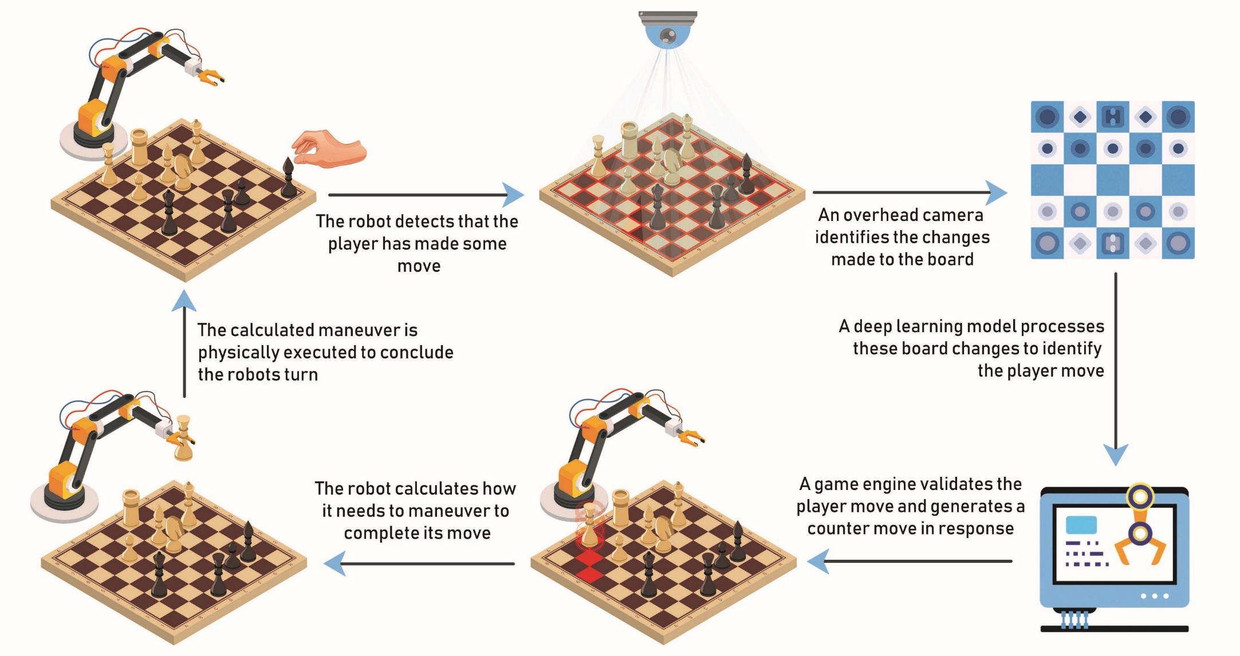
Working Architecture

Slide 9
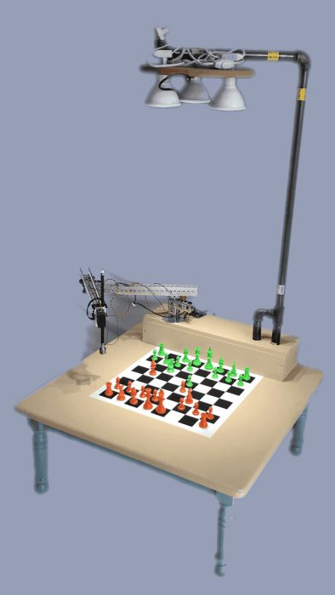
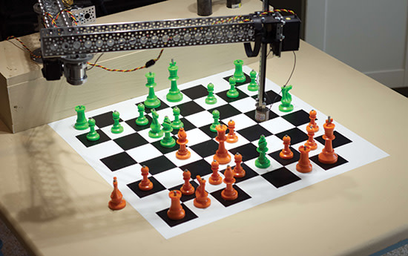
Proposed Chess Playing Robot

Slide 10
Applications
It can be used by beginners for learning and practicing the game.
Instead of playing chess on a mobile or computer, we can play it using an actual chess set.
It can be used in Robot Chess Competitions.
This robot could be invaluable for players who want to train in a realistic environment.

Slide 11
Tools & Technologies (Hardware)
Raspberry Pi 3
Raspberry Pi Camera Module
Arduino Uno/Mega
TowerPro MG995 servo motors - 3
TowerPro MG90s servo motor
TowerPro SG90 servo motor
Small Breadboard
Robotic Arm

Slide 12
Tools & Technologies (Software)
Raspian
Arduino IDE for Raspberry Pi (Linux ARM)
Python with opencv, numpy, matplotlib, tensorflow, chess
Chess Engine-Stock-fish (built from source for Linux arm)
Solidworks for Windows
Jupyter Notebook
Python
C++

Slide 13
Questions!!!

